Slide 1
SER Houston – Online Application
Team 1 – Vincent, Mayher, Angel, Sam, Brian, Hepson

Slide 2
Problems
Not user friendly
Mislead applicants – thought it was a job application
Too long
Not aesthetically pleasing
Incomplete applications
Users withheld sensitive information
Login information was a liability
Notes:
Typing was an obstacle to many applicants.

Slide 3
Simplicity and Accessibility
Emphasizes a page-by-page format that is user-friendly, concise, and manageable for the applicant
Provides a guided and interactive application process
Features:
Progress bar to help user visualize form completion
Drop-down menus and buttons to minimize typing
Text-message notifications
Pop-up reminders with contact information

Slide 4
Visuals
Pictures improve question comprehension for users
Buzzfeed-style quizzes cater to a broad spectrum of applicants
Improves communication with underprivileged and undereducated users
Gamifies the application process
Handles sensitive questions well
Makes the process casual and non-intimidating

Slide 5
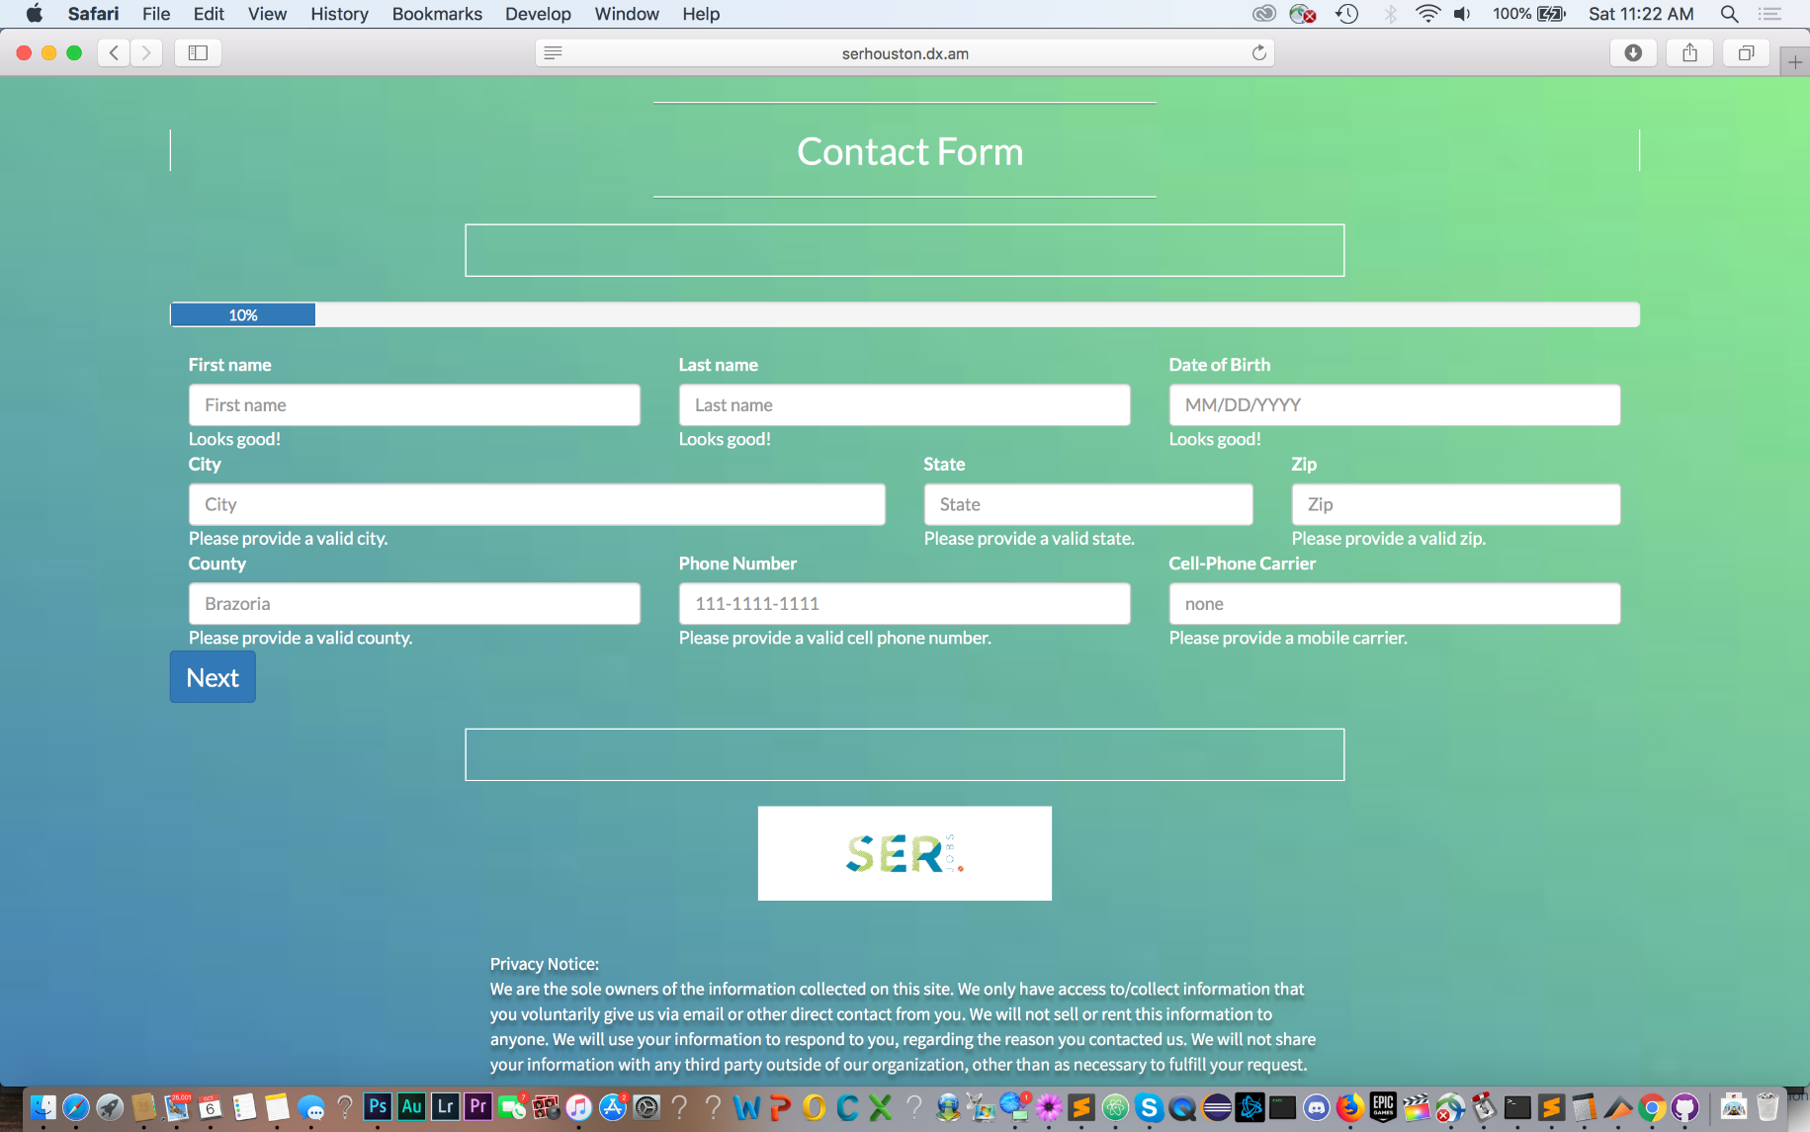
User Interface Screenshots

Slide 6
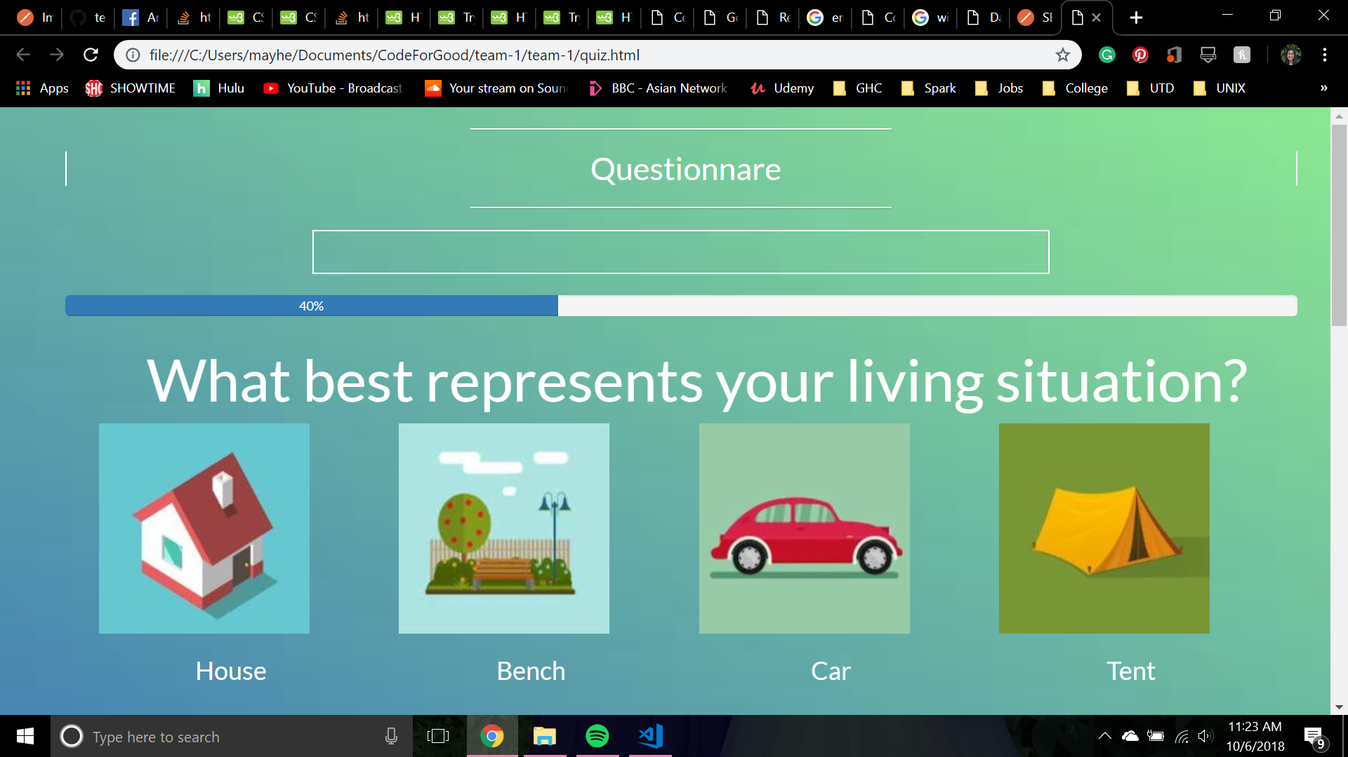
User Interface Screenshots

Slide 7
Demo

Slide 8
Questions

